Slide 1
Face Anti-Spoofing
BTech Project Presentation
By: Tadi Dinesh Kumar Reddy (200001075)
Under supervision of: Dr. Surya Prakash

Slide 2
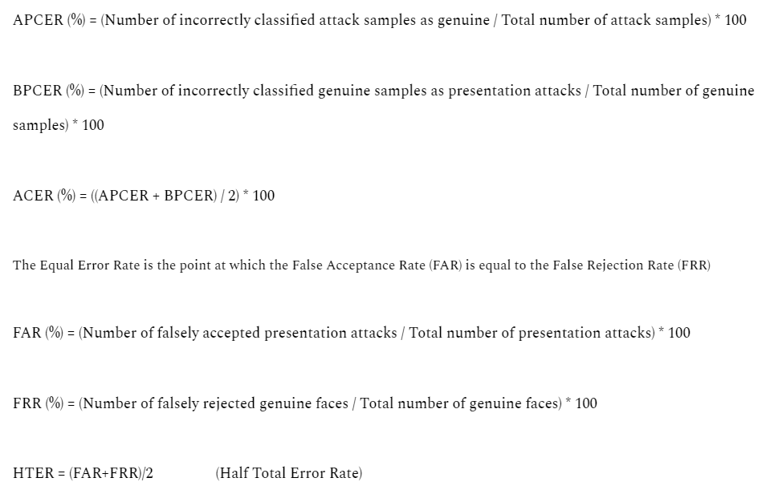
Metrics used for Face Anti-Spoofing

Slide 3
Searching Central Difference Convolutional Networks for Face Anti-Spoofing
Datasets used in paper
OULU-NPU, SiW, CASIA-MFSD, Replay-Attack, MSU-MFSD and SiW-M datasets used
Paper:
https://openaccess.thecvf.com/content_CVPR_2020/papers/Yu_Searching_Central_Difference_Convolutional_Networks_for_Face_Anti-Spoofing_CVPR_2020_paper.pdf

Slide 4
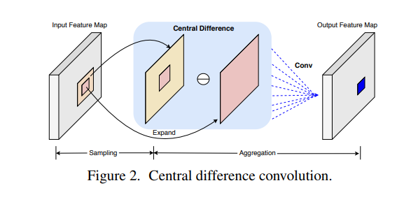
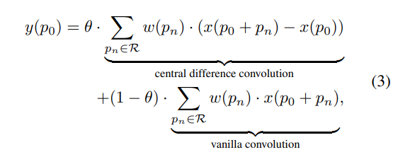
Searching Central Difference Convolutional Networks for Face Anti-Spoofing
CDC implementation:
For face anti-spoofing task,
both the intensity-level semantic info,
gradient-level detailed info are
crucial for distinguishing
the living and spoofing faces
So, a more generalized formula would be

Slide 5
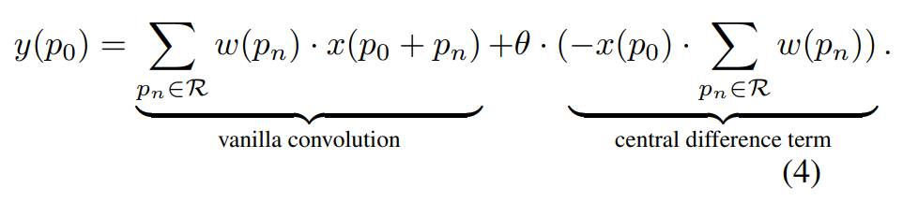

Searching Central Difference Convolutional Networks for Face Anti-Spoofing
CDC implementation:

Slide 6
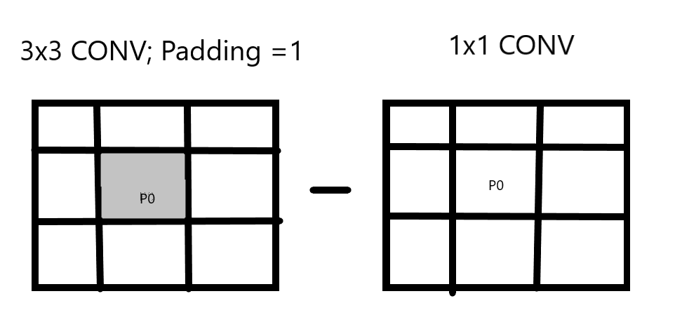
Searching Central Difference Convolutional Networks for Face Anti-Spoofing
CDC implementation:

Slide 7
Deep Pixel-wise Binary Supervision for Face Presentation Attack Detection
Datasets used
Replay-Mobile and OULU-NPU datasets were used
Paper:
https://ieeexplore.ieee.org/stamp/stamp.jsp?tp=&arnumber=8987370

Slide 8
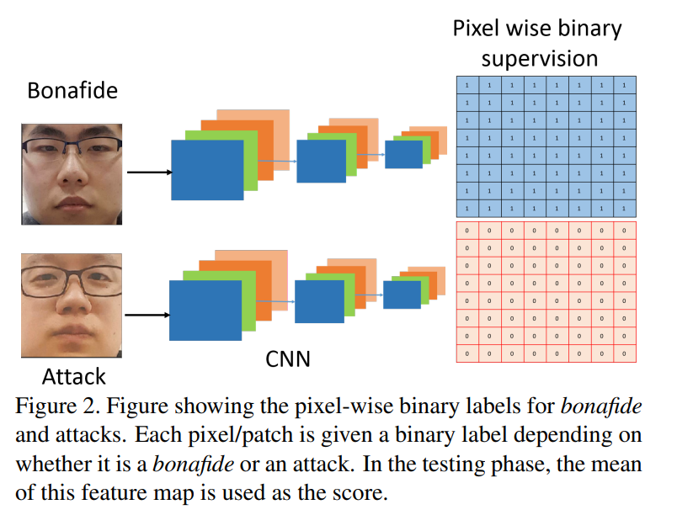
Deep Pixel-wise Binary Supervision for Face Presentation Attack Detection

Slide 9
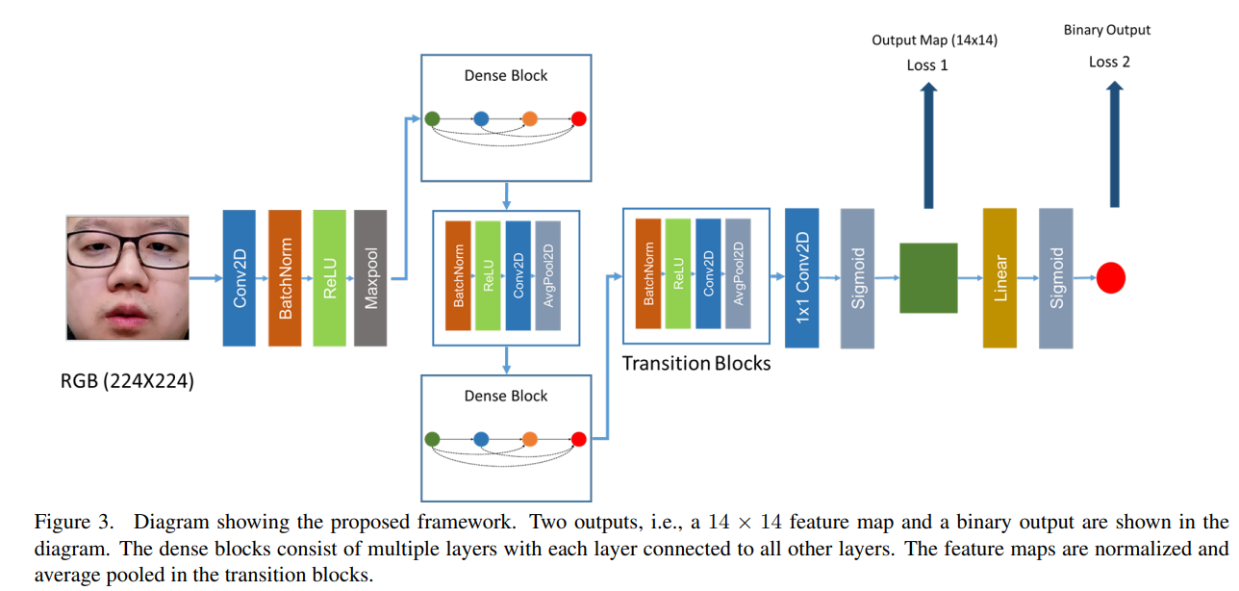
Deep Pixel-wise Binary Supervision for Face Presentation Attack Detection

Slide 10
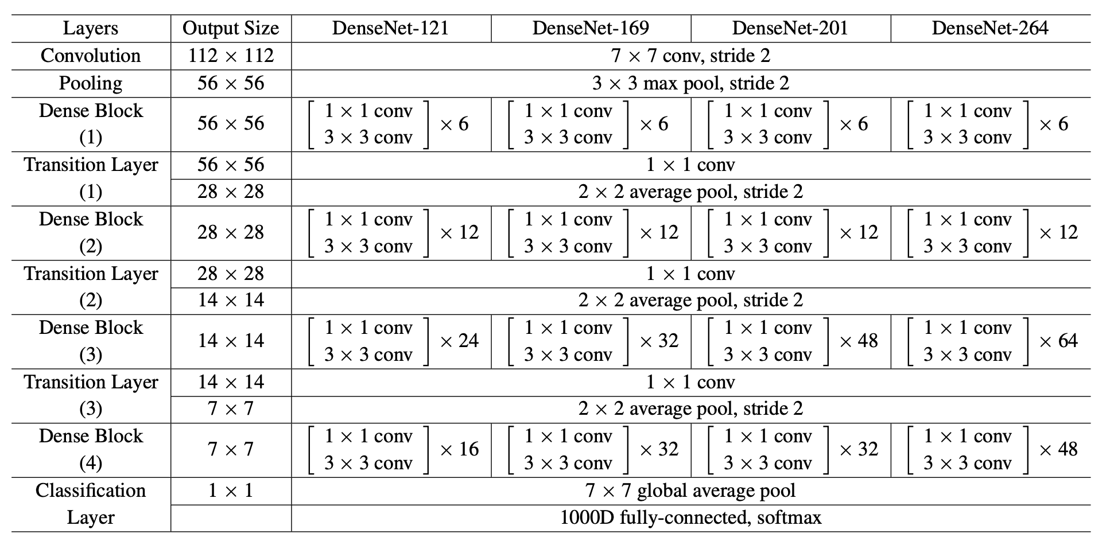
Deep Pixel-wise Binary Supervision for Face Presentation Attack Detection
Image reference: https://pytorch.org/hub/pytorch_vision_densenet/

Slide 11
On the Effectiveness of Vision Transformers for Zero-shot Face Anti-Spoofing
Datasets used
HQ-WMCA and SiW-M datasets used
Paper:
https://ieeexplore.ieee.org/stamp/stamp.jsp?tp=&arnumber=9484333

Slide 12
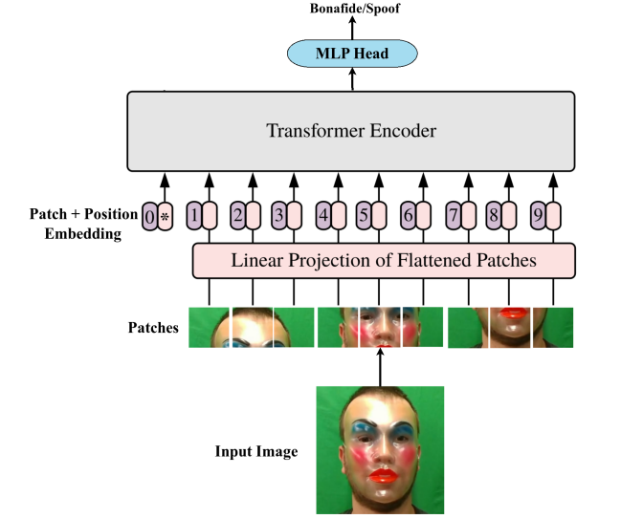
On the Effectiveness of Vision Transformers for Zero-shot Face Anti-Spoofing
ViT used : https://github.com/google-research/vision_transformer
(https://arxiv.org/abs/2010.11929)
The last layer is replaced with a
fully connected layer with one output node
and the model is fine-tuned using BCE loss.
The training and evaluation components
were implemented using the Bob2 library.

Slide 13
On the Effectiveness of Vision Transformers for Zero-shot Face Anti-Spoofing
For training, the pre-trained vision transformer model is taken and the final classification head is removed.
A new fully connected layer is added on top of the embedding followed by a sigmoid layer and trained with BCE loss.
“Adapting only the FC layer achieves the best results.”
Self-attention as opposed to convolutions helps to attend to all pairwise interactions in the lower layers.

Slide 14
Dataset

Slide 15
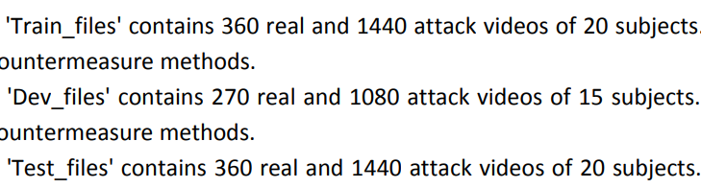
OULU-NPU dataset and preprocessing
A mobile face presentation attack database with real-world variations
4950 real access and attack videos that were
recorded using front facing cameras of six different smartphones
video length was limited to five seconds
Dataset Link: https://sites.google.com/site/oulunpudatabase/

Slide 16
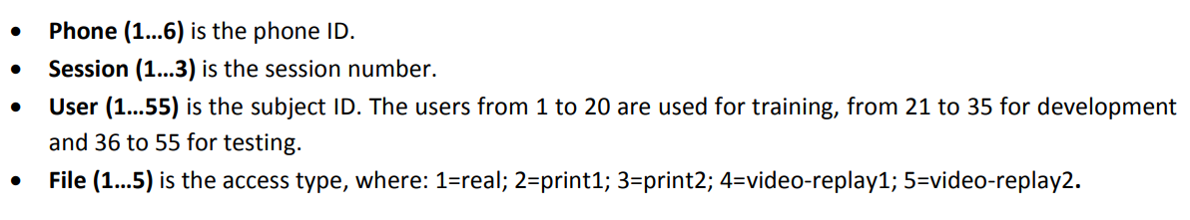
OULU-NPU dataset and preprocessing
In addition to the video files, the eye locations for each video is also given as text files
num_frame, x_eye_left, y_eye_left, x_eye_right, y_eye_right

Slide 17
OULU-NPU dataset and preprocessing
For each subject we have 5 files
1 - real
2,3 - print attacks (printed photo on a paper was fixed or hand-held)
4,5 - replay attacks (a recording of the person in a device was fixed or hand-held)

Slide 18
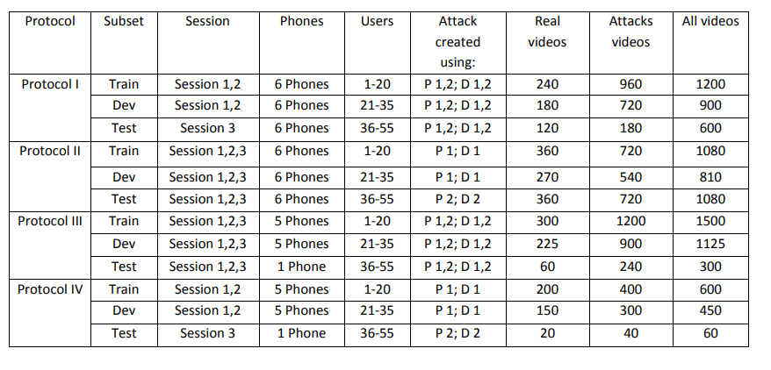
OULU-NPU dataset and preprocessing
4 evaluation protocols, usually used in papers using this dataset

Slide 19
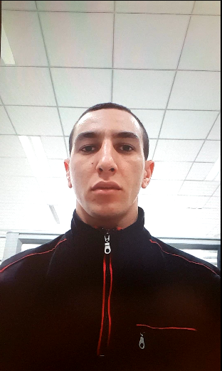
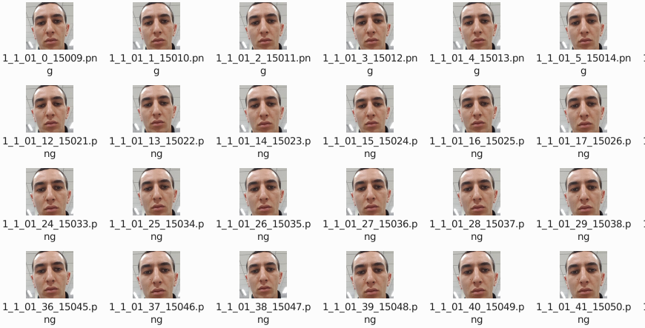
OULU-NPU dataset and preprocessing
Example from dataset What we finally need
1_1_01_1.avi

Slide 20
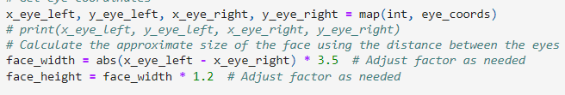
OULU-NPU dataset and preprocessing
We can use the eye coordinates in each frame to get an estimate of the face region.
Through extensive testing we can get the right hyperparameters that give least number of anomalous detections.

Slide 21



OULU-NPU dataset and preprocessing
The entire pre-processing gave:
Train:
Dev:
Test:

Slide 22
New Models

Slide 23
CDC-DenseNet

Slide 24
DenseNet with CDCN
Replaced the 3x3 kernel nn.conv2D operation with CDC operator
While leaving the 1x1 kernel operations as normal.
Modified the Densenet-161 architecture from Pytorch official Github page (https://github.com/pytorch/vision/blob/main/torchvision/models/densenet.py#L251)
Ran code by modifying and using the training code from CDCN code

Slide 25
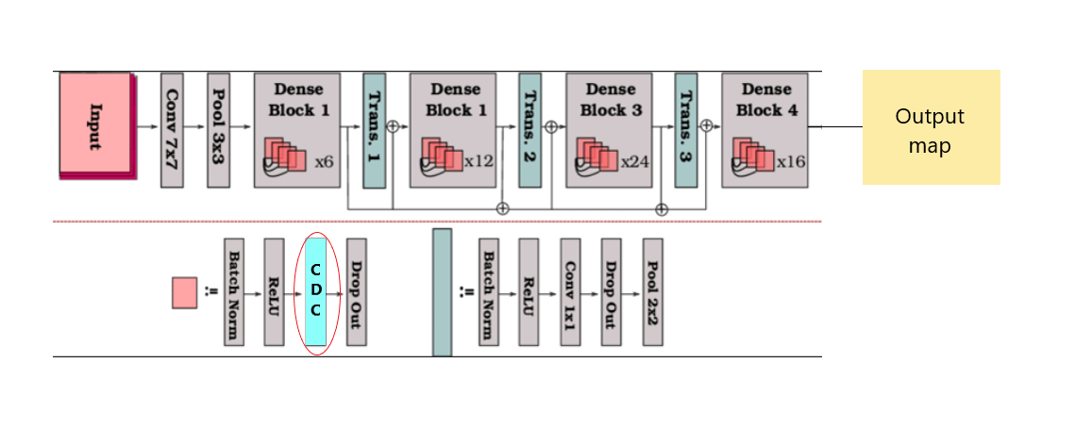
DenseNet with CDCN
Model diagram

Slide 26
DenseNet-ViT with Pixel Wise Binary Supervision

Slide 27
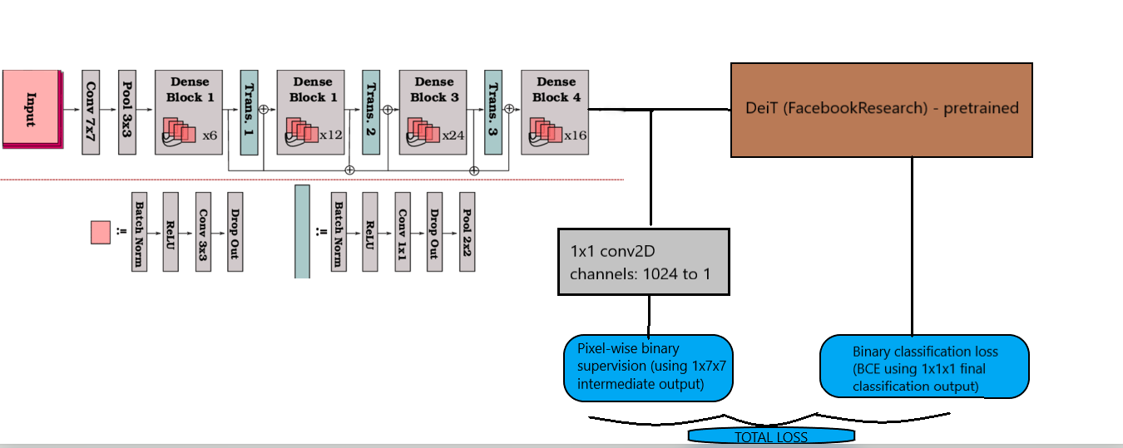
ViT(Deit) with Densenet backbone using Pixel wise binary supervision
Model Diagram
Densenet121 backbone

Slide 28
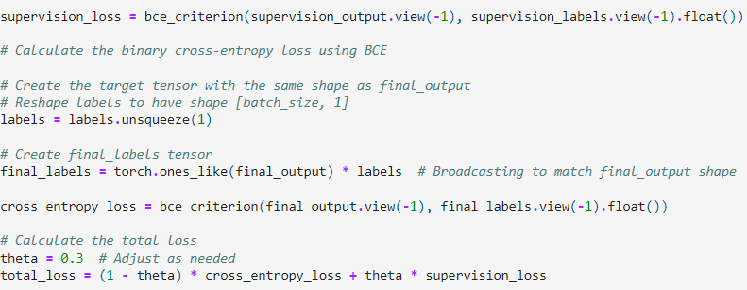
ViT(Deit) with Densenet backbone using Pixel wise binary supervision
Loss function: Total loss denoted with a weighted average of the
final binary classification loss (BCE loss) and pixel-wise binary supervision loss (BCE loss)

Slide 29
Results (Test Metrics)
Test Metrics: APCER, BPCER, ACER trained on entire train set.
Metric/Model | CDCN | CDC-Densenet | Densenet-ViT
APCER% | 0.21 | 1.67 | 2.87
BPCER% | 3.09 | 6.92 | 0.61
ACER% | 1.66 | 4.30 | 1.74

Slide 30
Results (Test Metrics)
Densenet-ViT performing better than CDC-Densenet and metrics close to CDCN
Densenet-ViT: APCER: 2.87% (Higher APCER indicates it is more likely to incorrectly classify genuine faces as attacks.)
BPCER: 0.61% (Lower BPCER indicates it is less likely to incorrectly classify attacks as genuine.)
CDCN: APCER: 0.21% (Lower APCER indicates it is less likely to incorrectly classify genuine faces as attacks.)
BPCER: 3.1% (Higher BPCER indicates it is more likely to incorrectly classify attacks as genuine.)
Densenet-ViT is better for high-security applications as it is less likely to incorrectly classify attacks as genuine (lower BPCER). However, it might cause some inconvenience by potentially classifying genuine faces as attacks (higher APCER).
CDCN is more convenient for genuine users as it is less likely to classify genuine faces as attacks (lower APCER). However, it is more prone to allowing some attacks (higher BPCER), which may not be suitable for high-security applications.
Metric/Model | CDCN | Densenet-ViT
APCER% | 0.21 | 2.87
BPCER% | 3.09 | 0.61
ACER% | 1.66 | 1.74

Slide 31
References
Links
https://github.com/ZitongYu/CDCN/tree/master
https://github.com/laoshiwei/face-anti-spoofing
https://gitlab.idiap.ch/bob/bob.paper.deep_pix_bis_pad.icb2019
https://github.com/Saiyam26/Face-Anti-Spoofing-using-DeePixBiS
https://ieeexplore.ieee.org/stamp/stamp.jsp?tp=&arnumber=8987370
https://openaccess.thecvf.com/content_CVPR_2020/papers/Yu_Searching_Central_Difference_Convolutional_Networks_for_Face_Anti-Spoofing_CVPR_2020_paper.pdf
http://parnec.nuaa.edu.cn/_upload/tpl/02/db/731/template731/pages/xtan/NUAAImposterDB_download.html
https://www.researchgate.net/publication/334170752_Leveraging_Sparse_and_Dense_Features_for_Reliable_State_Estimation_in_Urban_Environments
https://ieeexplore.ieee.org/stamp/stamp.jsp?arnumber=9484333
https://github.com/pineapple45/anti-face-spoofing-techniques/blob/master/Siamese-Network-Anti-spoofing/DataGeneration.ipynb

Slide 32
Dataset References
Dataset Papers & Links
https://sites.google.com/site/oulunpudatabase/
Z. Boulkenafet, J. Komulainen, L. Li, X. Feng and A. Hadid, "OULU-NPU: A Mobile Face Presentation Attack Database with Real-World Variations", 12th IEEE International Conference on Automatic Face & Gesture Recognition (FG 2017), 2017, pp. 612-618, doi: 10.1109/FG.2017.77.
https://www.idiap.ch/en/dataset/replayattack
Chingovska, A. Anjos, S. Marcel,"On the Effectiveness of Local Binary Patterns in Face Anti-spoofing"; IEEE BIOSIG, 2012.

Slide 33
References
Papers
Yu, Zitong, et al. "Searching central difference convolutional networks for face anti-spoofing." Proceedings of the IEEE/CVF Conference on Computer Vision and Pattern Recognition. 2020.
George, Anjith, and Sébastien Marcel. "Deep pixel-wise binary supervision for face presentation attack detection." 2019 International Conference on Biometrics (ICB). IEEE, 2019.
George, Anjith, and Sébastien Marcel. "On the effectiveness of vision transformers for zero-shot face anti-spoofing." 2021 IEEE International Joint Conference on Biometrics (IJCB). IEEE, 2021.

